Slide 1
6.8 Classification Quality Metrics

Slide 2
In this Section we describe simple metrics for judging the quality of a trained two-class classification model, as well as how to make predictions using one.

Slide 3
Making predictions using a trained model

Slide 4
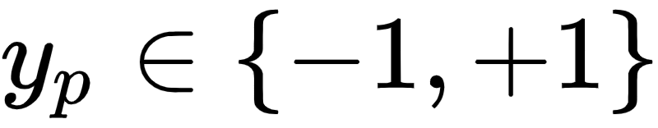

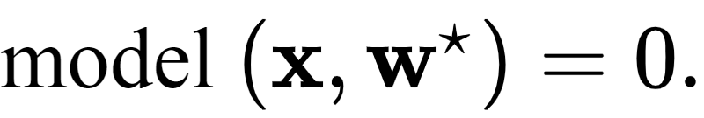
Suppose we have an optimal set of weights found by minimizing a classification cost function (employing by default label values ).
Denote this set of optimal weights then we can write our fully tuned linear model as
This fully trained model defines an optimal decision boundary for the training dataset which takes the form

Slide 5


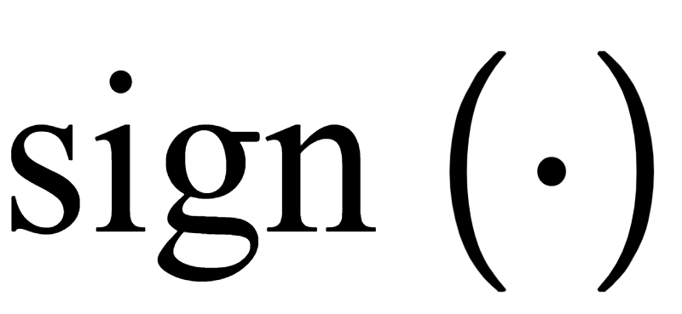
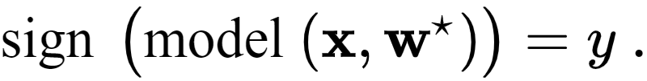
To predict the label of an input we then process this model through an appropriate step function.
This step function is conveniently defined by the function (as detailed in [Section 6.3], and the predicted label for is given as

Slide 6
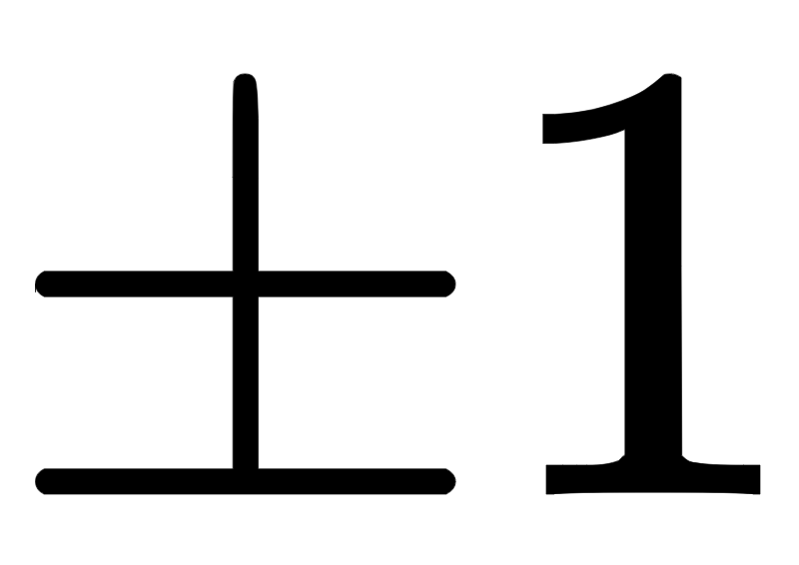
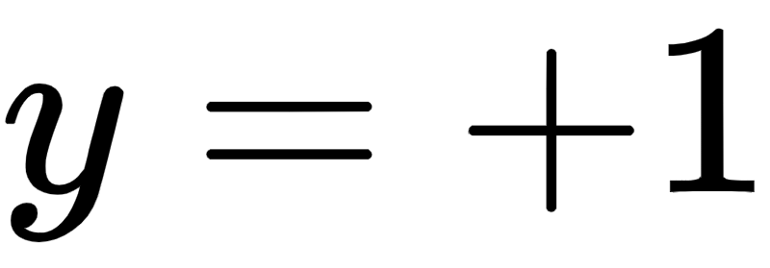
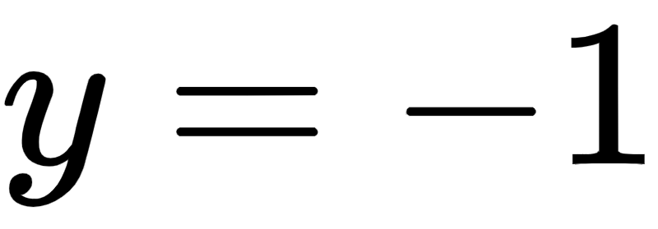
This evaluation will always take on values if does not lie *exactly* on the decision boundary.
If it does lie directly on the boundary we assign a random value from to the point.
It simply computes which side of the decision boundary the input lies on.
If it lies 'above' the decision boundary then , and if 'below' then . This is illustrated in the figure below.

Slide 7
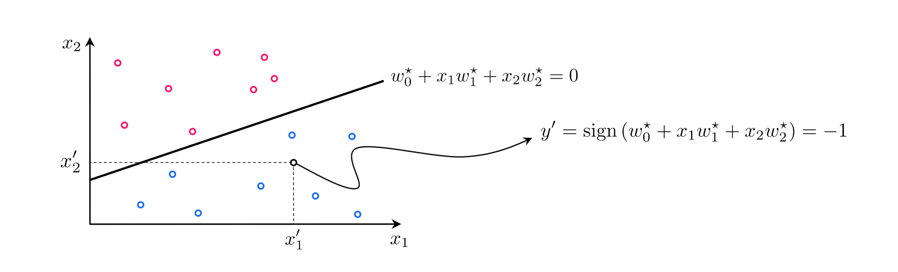

Slide 8
Confidence scoring

Slide 9
Once a proper decision boundary is learned, we can judge its *confidence* in any point based on *the point's distance to the decision boundary*.
We say that our classifier has *zero* confidence in points lying along the decision boundary itself, why?
Because the boundary cannot tell us accurately which class such points belong too (which is why they are randomly assigned a label value if we ever need to make a prediction there).

Slide 10
Likewise we say that *near* the decision boundary we have *little confidence* in the classifier's predictions. Why?
Imagine we apply a small perturbation to the decision boundary, changing its location ever so slightly.
Some points *very close to the original boundary* will end up on the *opposite* side of the new boundary, and will consequently have *different predicted labels*.

Slide 11
Conversely, this is why we have *high confidence* in the predicted labels of points *far* from the decision boundary.
These predicted labels will not change if we make a small change to the location of the decision boundary.

Slide 12
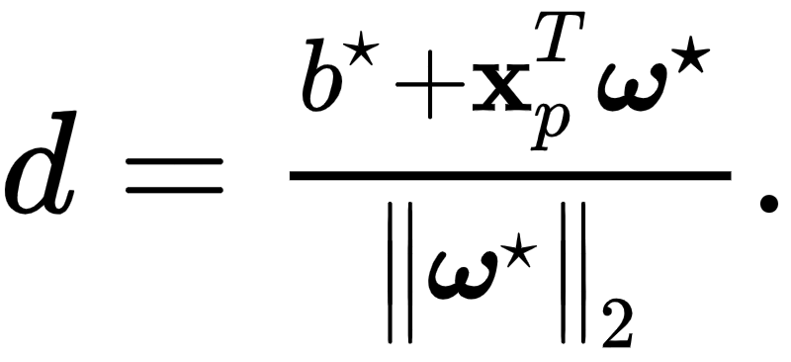
The notion of 'confidence' can be made precise and normalized to be universally applicable by running the point's distance to the boundary through the *sigmoid function* (see [Section 6.2])
This gives the confidence that a point belongs to class +1.
The signed distance d from a point to the decision boundary provided by our trained model can be computed (see [Section 6.4]) as

Slide 13
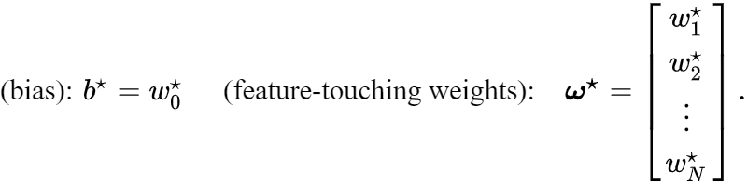
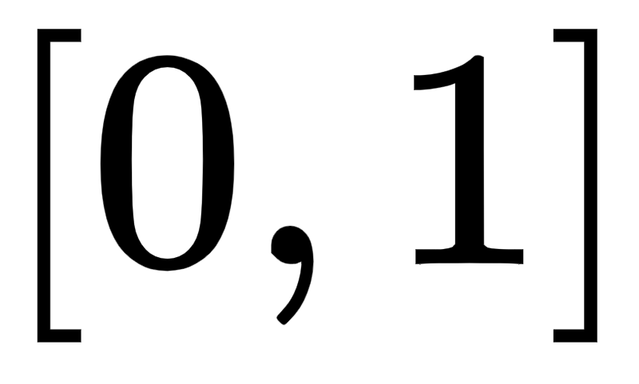
Here we denote
By evaluating d using the *sigmoid function* as...
...we squash it smoothly onto the interval

Slide 14
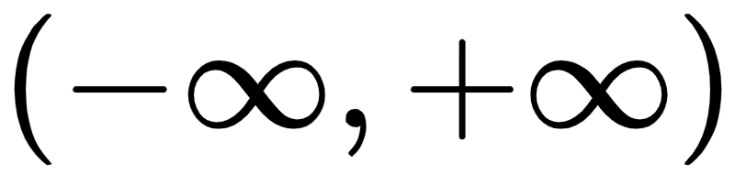
When this value equals 0.5 the point lies on the boundary itself.
If the value is greater than 0.5 the point lies on the positive side of the decision boundary and so we have larger confidence in its predicted label being +1.
When the value is less than 0.5 the point lies on the *negative* side of the classifier, and so we have less confidence that it truly has label value +1.
Because normalization employing the sigmoid squashes down to the interval this confidence value is often interpreted as a *probability*.

Slide 15
Judging the quality of a trained model using *accuracy*

Slide 16
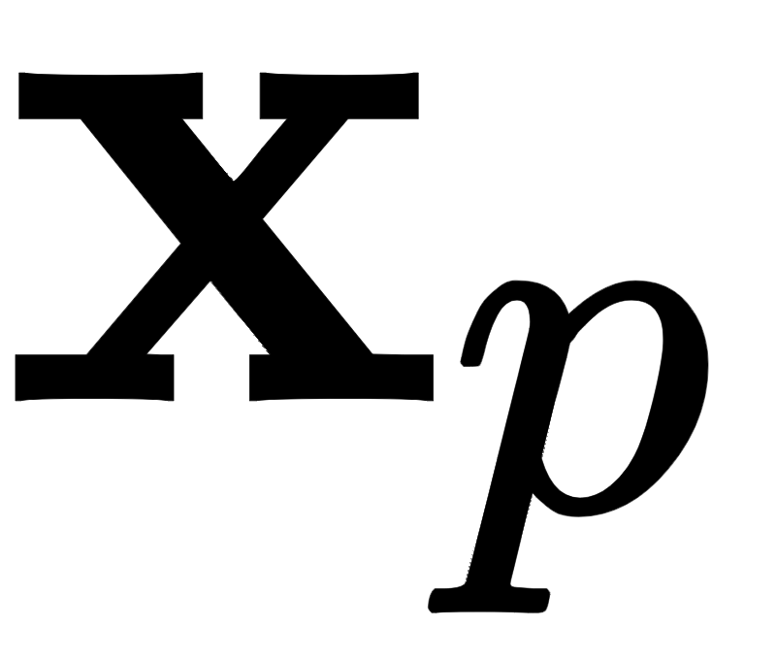
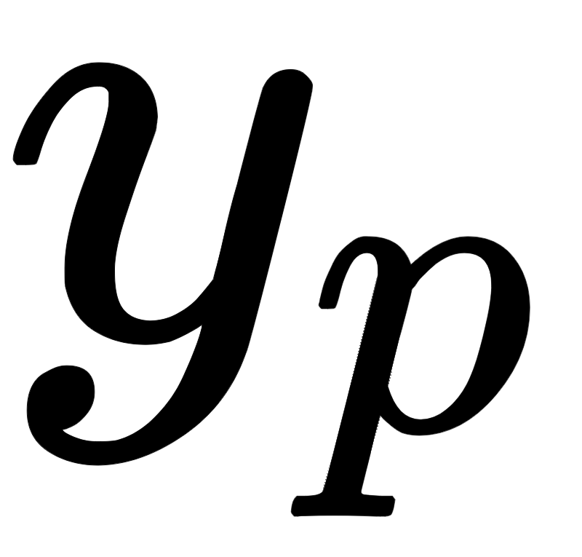
Once we have successfully minimized the a cost function for linear two-class classification it can be a delicate matter to determine our trained model's quality.
The simplest metric for judging the quality of a fully trained model is to simply count the number of misclassifications it forms over our training dataset.
This is a raw count of the number of training datapoints whose true label is predicted incorrectly by our trained model.

Slide 17
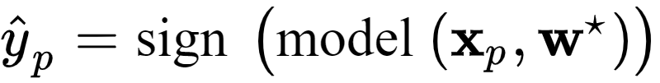
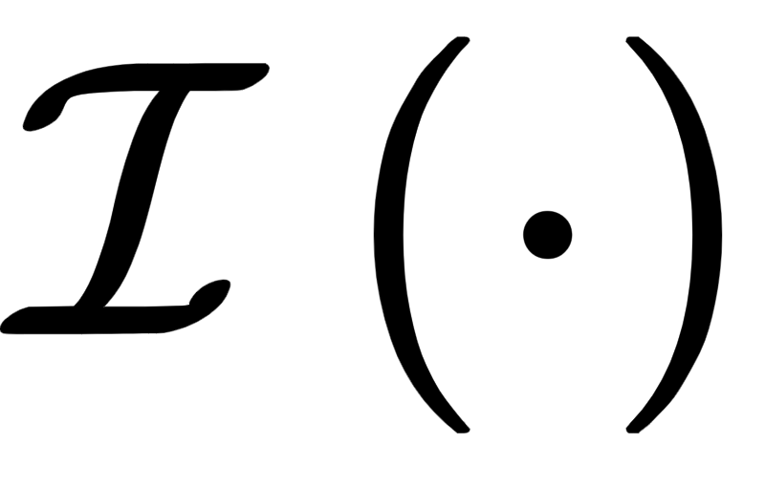
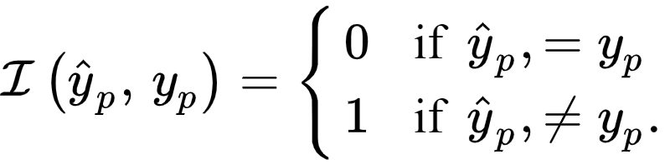
To compare the point 's predicted label and true label we can use an identity function and compute
Summing all P points gives the total number of misclassifications of our trained model

Slide 18

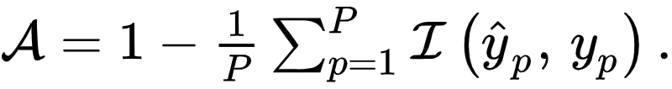
Using this we can also compute the *accuracy* - denoted - of a trained model.
This is simply the percentage of training dataset whose labels are correctly predicted by the model.
The accuracy ranges from 0 (no points are classified correctly) to 1 (all points are classified correctly).

Slide 19
Example: Comparing the Softmax to the number of misclassifications during runs of gradient descent

Slide 20
Our classification cost functions are - in the end - based on smooth approximations to a discrete step function.
This is the function we truly wish to use, i.e., the function through which we truly want to tune the parameters of our model.
However since we cannot easily optimize this step function - as discussed in Sections [6.2] and [6.3] - we settle for a smooth approximation.
The consequences of this practical choice are seen when we compare the cost function history from a run of gradient descent to the corresponding misclassification count measured at each step of the run.

Slide 21
We show such a comparison using the dataset from Example 1 of [Section 6.4].
In fact we show such results of three independent runs of gradient descent, with the history of misclassifications shown in the left panel and corresponding Softmax cost histories show in the right panel.
Each run is color-coded to distinguish it from the other runs.

Slide 22
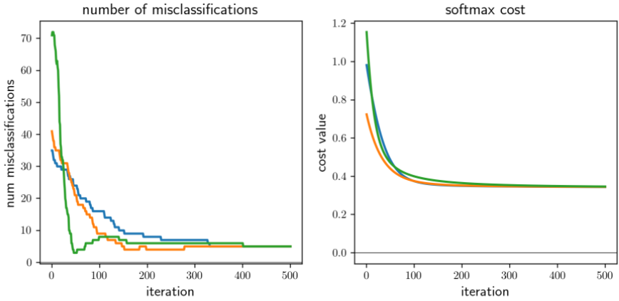

Slide 23
Comparing the left and right panels we can see that the number of misclassifications and Softmax evaluations at each step of a gradient descent run do not perfectly track one another.
That is, it is not the case that just because the cost function value is decreasing that so too is the number of misclassifications.
Again, this occurs because our Softmax cost is only an approximation of the true quantity we would like to minimize.

Slide 24
This simple example has an extremely practical implication.
After a running a local optimization to minimize a two-class classification cost function the best step, and corresponding weights, are associated with the lowest *number of misclassifications*.
Or likewise the *highest accuracy* (or, as we see below, an advanced metric).
We do **not** choose weights associated with the lowest cost function value.

Slide 25
Judging the quality of a trained model using *balanced accuracy*

Slide 26
Classification accuracy is an excellent basic measurement of a trained classifier's performance.
However in certain scenarios using the accuracy metric can paint an incomplete picture of how well we have really solved a classification problem.
For example when a dataset consists of *highly imbalanced classes*.
That is when a dataset has far more examples of one class than the other - the 'accuracy' of a trained model loses its value as a metric.

Slide 27
This is because when one class greatly outnumbers the other in a dataset an accuracy value close to 1 can be misleading.
If one class makes up 95% percent of all data points, a naive classifier that blindly assigns the label of the majority class to *every training point* achieves an accuracy of 95%.
But here misclassifying 5% amounts to *completely misclassifying an entire class of data*.

Slide 28
This imaginary scenario points to the main problem with the use of *accuracy* as a proper metric for diagnosing classifier performance on datasets with highly imbalanced classes:
Because it weights *misclassifications from both classes equally* it fails to convey how well a trained model performs on each class of the data individually.
This results in the potential for strong performance on a very large class of data masking poor performance on a very smaller one.
The simplest way to improve the accuracy metric to compute accuracy on *each class individually* and combine the resulting metrics.

Slide 29
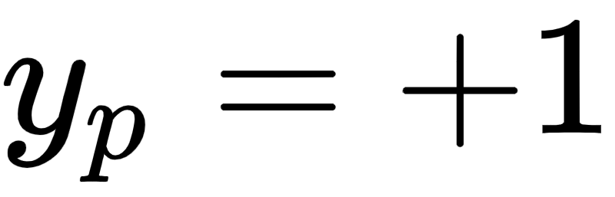
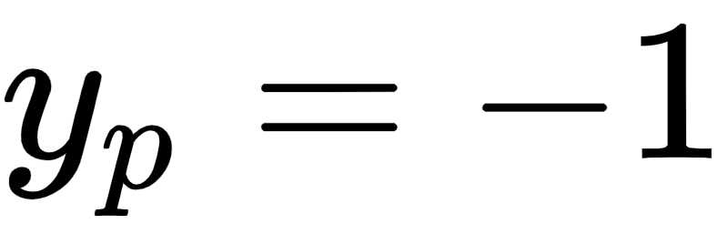
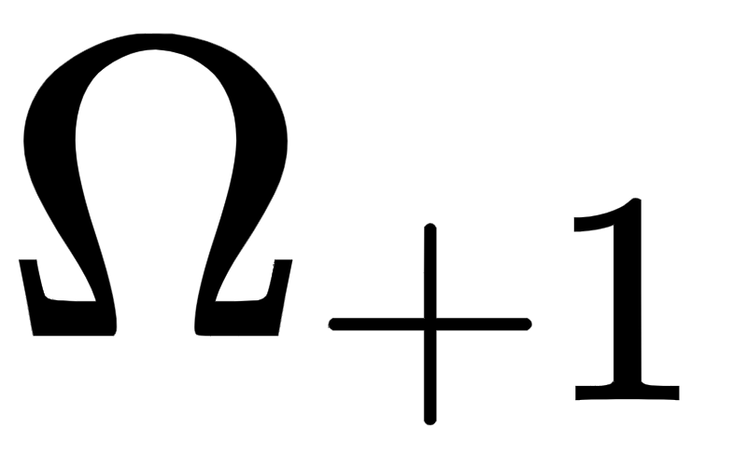
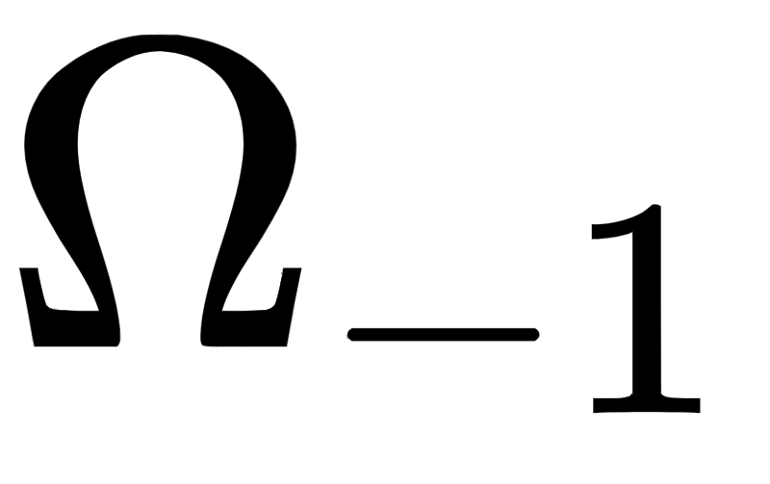
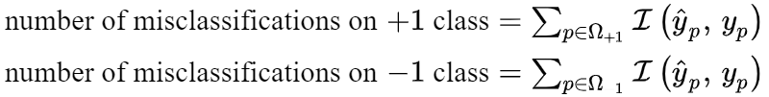
Denote the indices of those points with labels and as and respectively.
Then we compute the number of misclassifications on each class individually as

Slide 30
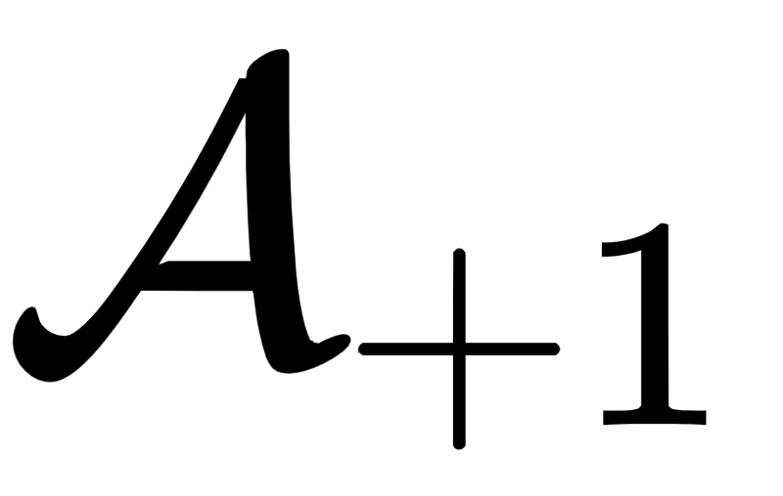
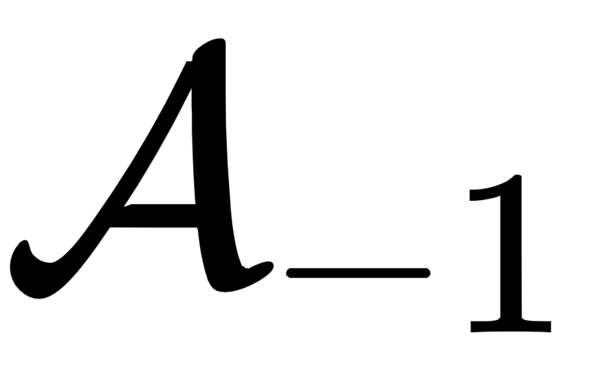
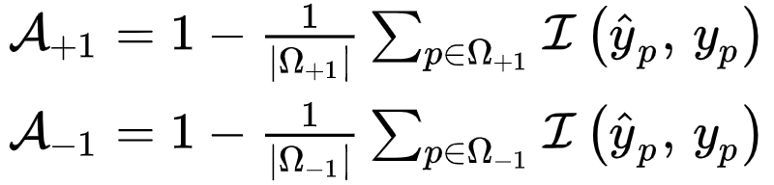
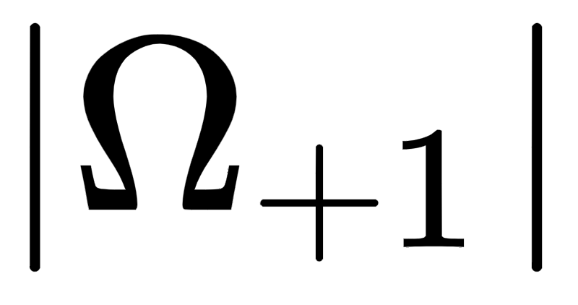
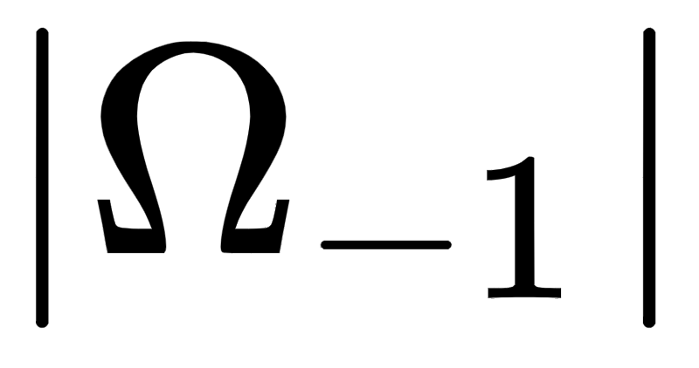
The accuracy on each class individually can then be likewise computed as (denoting the accuracy on class +1 and -1 individually as and respectively)
Note here the and denote the number of points belonging to the +1 and -1 class respectively.

Slide 31
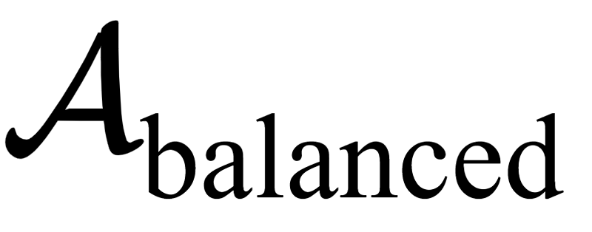
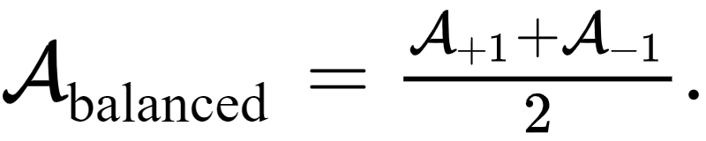
We can then combine these two metrics into a single value by taking their average. This combined metric is called balanced accuracy (which we denote as )

Slide 32
Lets return to our motivating scenario - where we imagined a highly imbalanced dataset with 95% membership in one class and 5% in the other.
Simply classifying the entire space as the majority class achieves a 95\% accuracy metric.
We can capture the fact that one class has been completely misclassified with the individual class accuracy measurements above.

Slide 33
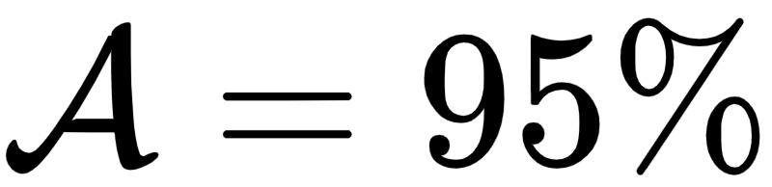
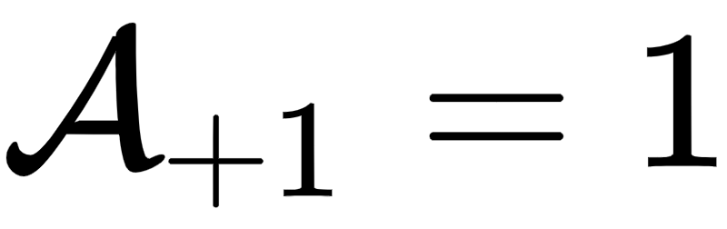
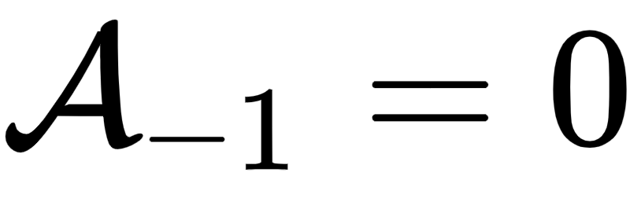
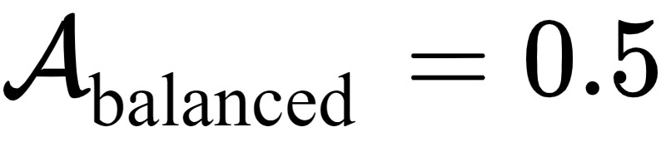
Suppose that the +1 class is the majority then while the overall accuracy is , the accuracy on each class individually is and respectively.
These metrics accurately reflect the fact that the naive classifier correctly classifies the entire +1 class, but incorrectly classifies the entire -1 class.
Their average - the balanced accuracy metric - also captures this fact since it then takes on the value .

Slide 34
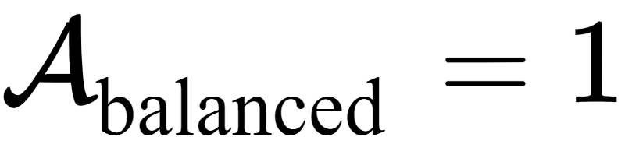
The balanced accuracy metric ranges from 0 to 1.
When equal to 0 no point is classified correctly, and when both classes are classified perfectly .
Note: if both classes are classified equally well the balanced accuracy reduces to the overall accuracy value .

Slide 35
Values of the metric in between 0 and 1 measure how well - on average - each class is classified individually
e.g., as we have seen can occur one class is completely misclassified while the other is classified perfectly.
Balanced accuracy is a simple metric for helping us understand whether our learned model has 'behaved poorly' on highly imbalanced datasets.

Slide 36
In order to improve the behavior of our learned model in such instances we have to adjust the way we perform two class classification.
One popular way of doing this - called weighted classification - is discussed in the next Section.

Slide 37
The confusion matrix and additional quality metrics

Slide 38
Additional metrics for judging the quality of a trained model for two class classification can be formed using the confusion matrix.
A confusion matrix is a simple lookup table where classification results are broken down by actual (across rows) and predicted (across columns) class membership.

Slide 39
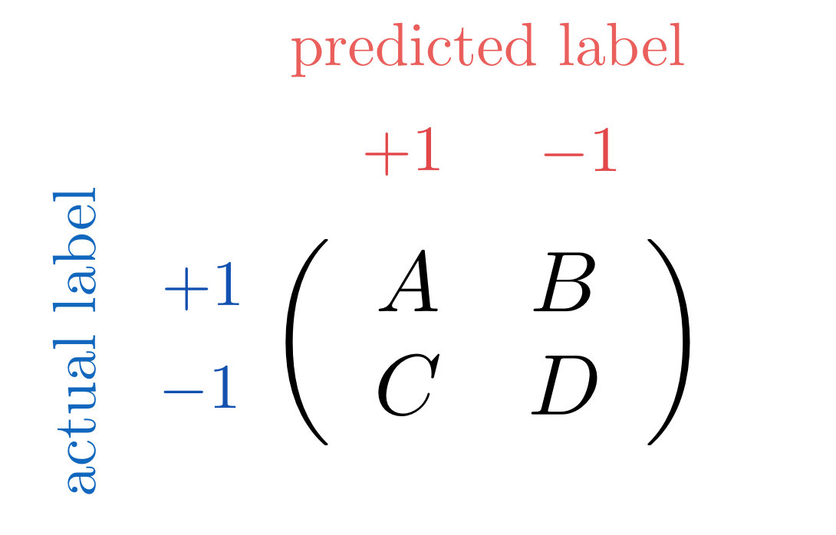

Slide 40
Here we denote A is the number of data points whose actual label, +1, is identical to the label assigned to them by the trained classifier.
The other diagonal entry D is similarly defined as the number of data points whose predicted class, -1, is equal to their actual class.
The off-diagonal entries denoted by B and C represent the two types of classification errors wherein the actual and predicted labels do not match one another.
In practice we want these two values to be as small as possible.

Slide 41
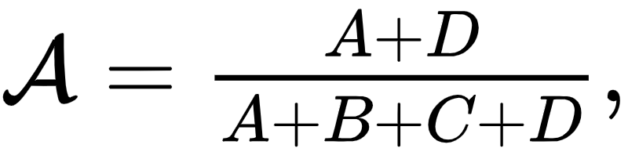
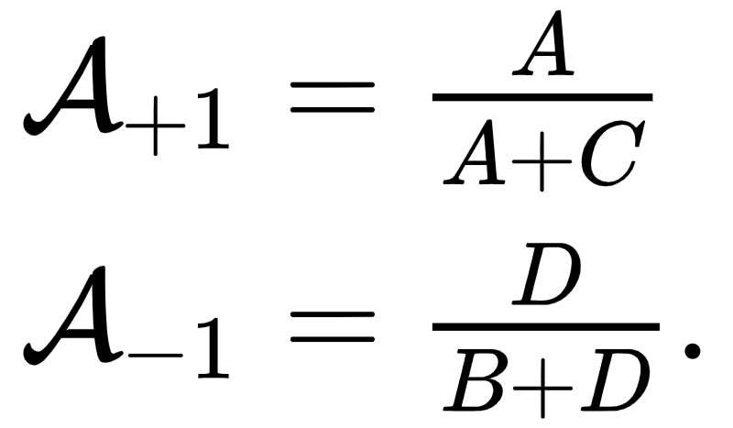
Our accuracy metric can be expressed in terms of the confusion matrix quantities as
As can our accuracy on each individual class

Slide 42
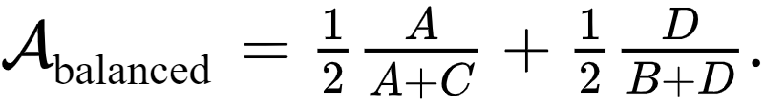
The balanced accuracy metric can likewise be expressed as

